Slide 1
Chapter: Secondary-Storage Structures
By: Navjot Kaur

Slide 2
Secondary Storage Structure
Disk is secondary storage that is used to store data
The data is provided to user programs by means of I/O requests.
Disk Structure
Disk is divided into tracks cylinder and sectors.
Data is stored on series of magnetic disks called Platters, connected by spindle.
Surface of platter is divided into circular rings called Tracks
Tracks are divided into Sectors.
Sectors are of fixed sized.
Tracks are one arm position form a cylinder.

Slide 3
Secondary Storage Structure
Cylinder contains one track per platter surface.
Sector stores 512 or 1024 bytes of user data.
Sector is identified by: Cylinder no., track no. with in cylinder and position no. In track.
Cylinder is numbered starting with zero , from outer to inner most cylinder
Tracks are numbered starting with zero from top track to bottom
Sector start with zero ant iclock wise starting from reference position.

Slide 4
Secondary Storage Structure
Storage Devices can be categorized in to 3 types:
1. Random Access Memory
2. Serial Storage Device
  The data is written on tape.
  Data is read in a serial / sequential manner
  Exp: Magnetic Tape
3. Direct Access Storage
  Exp: Magnetic Disk
  Floppy disk
  CD etc.

Slide 5
Secondary Storage Structure
Some devices are:
Character Devices | Block Devices
Devices in which data is accessed character by character or byte by byte. If we want to write data , it can be written in form of character or byte. Example: Printer | Entire block of data is accessed or written. Example: Magnetic Disk Floppy or CD

Slide 6
Magnetic Tape
Data is written on tape
Entire tape is divided into 9 tracks for storing the data
First 8 tracks will contain 8 bits and 9th track is used to contain parity bit.
Entire tape pass through read write head
A Read/Write head is an Array of 9 read/write heads
Data is stored in the form of records
Multiple bytes form a record.

Slide 7
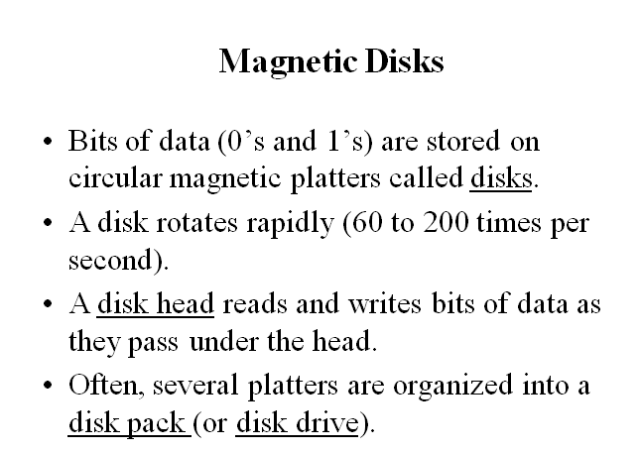
Magnetic Disk

Slide 8
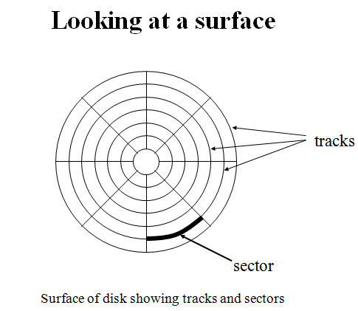
Disk Surface

Slide 9
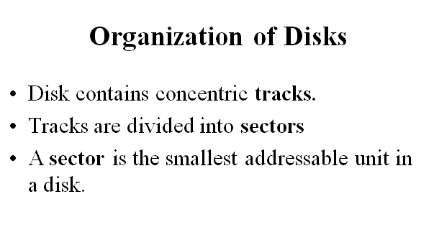

Slide 10

Moving-head Disk Machanism

Slide 11
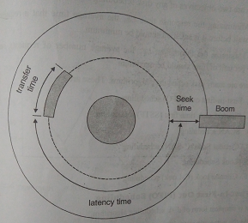
Component of Disk
time spent in actually
moving data to from
the disk surface
Time to move
head to desired
track
Time taken to reach
the portion of disk on which
data record is stored

Slide 12
Mass Storage Structure
Seek Time: It is the time required to move a head to the required track.
Latency Time: It is the amount of time it takes the portion of disk on which data record is stored to spin under read/write head.
Transfer time: time spent in actually moving data to from the disk surface.
It is amount of information to be read, the number of bytes per track and rotation speed.
Total Access Time: it is Seek time + Latency Time + Transfer Time

Slide 13
Disk Scheduling
Scheduling is mechanism of arranging requests in order to save un-necessary rotations by disk arm and disk pointer.
OS takes I/O requests from queue and process them one by one. Algo. used to select which I/O request is going to be selected first is called Disk Scheduling Algorithm
Objective:
Minimize response time
Maximize Throughput.
Response Time: Avg. time that a request must wait before it is satisfied
Throughput: Avg. number of requests satisfied per unit of time.

Slide 14
Disk Scheduling
The operating system is responsible for using hardware efficiently — for the disk drives, this means having a fast access time and disk bandwidth.
Access time has two major components
  Seek time is the time for the disk are to move the heads to the cylinder containing the desired sector.
  Rotational latency is the additional time waiting for the disk to rotate the desired sector to the disk head.
Minimize seek time
Seek time ≈ seek distance

Slide 15
FCFS
Several algorithms exist to schedule the servicing of disk I/O requests.
A disk size of 200 tracks receives the requests for the blocks for I/O operation. No. of blocks requested on disk are:
98, 183, 37, 122, 14, 124, 65, 67
Head pointer/ Disk arm is at 53

Slide 16

FCFS
Illustration shows total head movement of 640 cylinders.

Slide 17
FCFS
Illustration shows total head movement of 640 cylinders.
Total Head Movements:
|53-98| + |98-183| + |183- 37| + | 37-122| + |122-14| + |14-124| +
|124-65| + |65-67|
= 640

Slide 18
FCFS Example
A disk size of 200 tracks receives the requests for the blocks for I/O operation. No. of blocks requested on disk are: 23, 89, 132, 42, 187, 60. Disk arm is at track 100.
Hint: Total head movements: 548

Slide 19
SSTF- Shortest Seek Time First
Selects the request with the minimum seek time from the current head position.
SSTF scheduling is a form of SJF scheduling; may cause starvation of some requests.
Illustration shows total head movement of 236 cylinders.

Slide 20

SSTF (Cont.)
5) 53-98=45 8) 53-183=130 3) 53-37=16 6)53-122=69 4)53-14=39 7) 53-124=71 53-65=12 53-67=14

Slide 21
SSTF- Shortest Seek Time First
Exp: 23,89,132,42,187,60. Disk head is at position 100
Find total head movements.
Hint: 241

Slide 22
SCAN
The disk arm starts at one end of the disk, and moves toward the other end, servicing requests until it gets to the other end of the disk, where the head movement is reversed and servicing continues.
A request arriving behind the head will have to wait until the arm moves to the end of the disk, reverses direction and comes back.
Sometimes called the elevator algorithm.
Illustration shows total head movement of 208 cylinders.
Example: Previously head is at 60. so from 60 we go to 53 i.e left
But if previously if head is at 5 then direction will be towards right. By deafult: left direction.

Slide 23

SCAN (Cont.)

Slide 24
SCAN
Advantage
Throughput is better than FCFS
If a request arrive in a queue just in front of the head, it will be serviced immediately.
Disadvantage:
The disk arm always starts from the beginning, no matter other number of requests are present on the other end of disk.

Slide 25
C-Scan
C-SCAN moves the head from one end servicing all the requests to the other end.
However, as soon as the head reaches the other end, it immediately returns to the beginning of the disk without servicing any requests on the return trip and starts servicing again once reaches the beginning.
This is also known as the “Circular Elevator Algorithm

Slide 26
C-Scan
It is an enhancement of SCAN algorithm.
Head moves from one end of disk to the other servicing the request along the way.
When the disk arm reaches the end it quickly returns to the other end without fulfilling any request in the way
It restricts servicing request from one direction only.
My cylinder are rising from 0 to n-1 and wise versa. Next will be 0
It will move in increasing order of cylinder number.
Head will go to extreme ends.
Move towards increasing direction of cylinder number

Slide 27
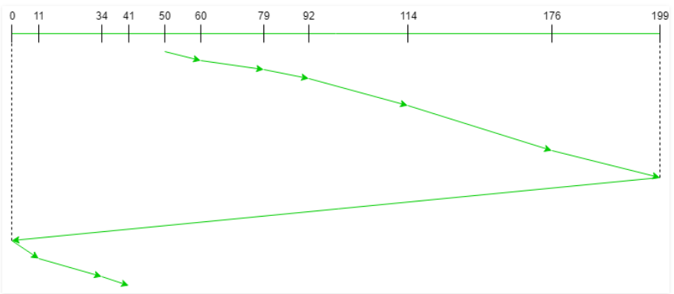
C-Scan Example
Request sequence = {176, 79, 34, 60, 92, 11, 41, 114}
Initial head position = 50
Direction = right(We are moving from left to right)

Slide 28
C-Scan
Suppose a disk is having 200 cylinder from 0 to 199. disk is currently searching for disk head 53. previous request was at head 60. the queue of pending request is in FIFO order.
98,183,37,122,14,124,65,67.
Find total head movements.
Ans:183

Slide 29
C-Scan
Consider request queue: 23,89,132,42,187,60
Head starts at number:100
Hint: head movements: |100-89|+|89-60|+|60-42|+|42-23|+|23-0|+ |0-199|+|199-187|+|187-132|
= 311
If previous head position is not given then see the total number of blocks from current head, then pick direction towards maximum number of blocks.

Slide 30
LOOK or C-LOOK
Same as SCAN
Arm Does not go to end.
Will not go beyond max(1.e 183) and beyond min(i.e. 14)
Arm only goes as far as the final request in each direction,
Then it reverses direction immediately, without first going all the way to the end of the disk.

Slide 31
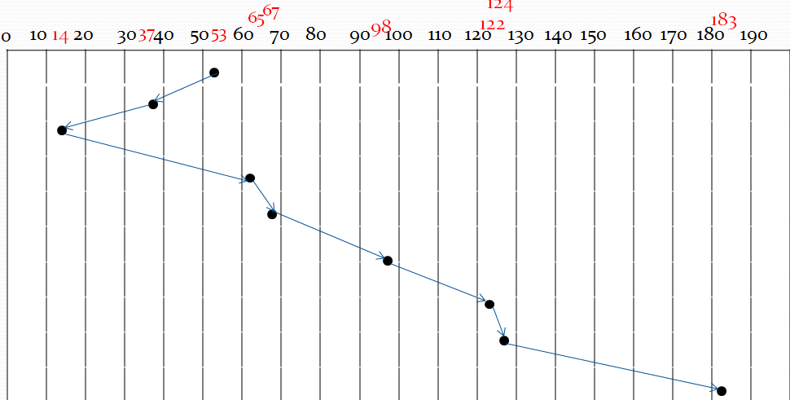
LOOK
Total head movements: 208

Slide 32
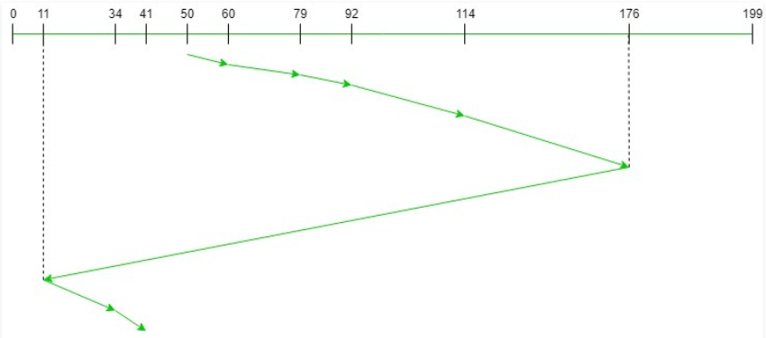
C- LOOK
Request sequence = {176, 79, 34, 60, 92, 11, 41, 114}
Initial head position = 50
Direction = right (Moving from left to right)

Slide 33
Selecting a Disk-Scheduling Algorithm
SSTF is common and has a natural appeal
SCAN perform better for systems that place a heavy load on the disk.
Performance depends on the number and types of requests.
Requests for disk service can be influenced by the file-allocation method.
The disk-scheduling algorithm should be written as a separate module of the operating system, allowing it to be replaced with a different algorithm if necessary.
Either SSTF or LOOK is a reasonable choice for the default algorithm.

